Slide 1
Assignment-III Advanced Spice modelling Electric/Electromagnetic and coupled physical effects
Group member:
SONG YANG
QU MINGXUAN
XIAO SA

Slide 2
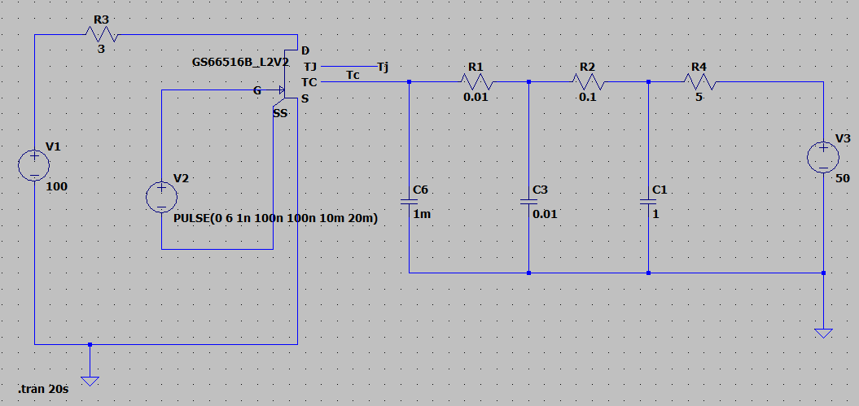
TASK – I Transient heating of a MOSFET under overcurrent conditions.
Circuit:
Set up a simulation using the transistor GS66516B to switch at 50% duty cycle at 50Hz. The transistor should drive a load of 3Ω from 100V source.
The circuit on the right is used as a heat sink to connect with transistor.

Slide 3
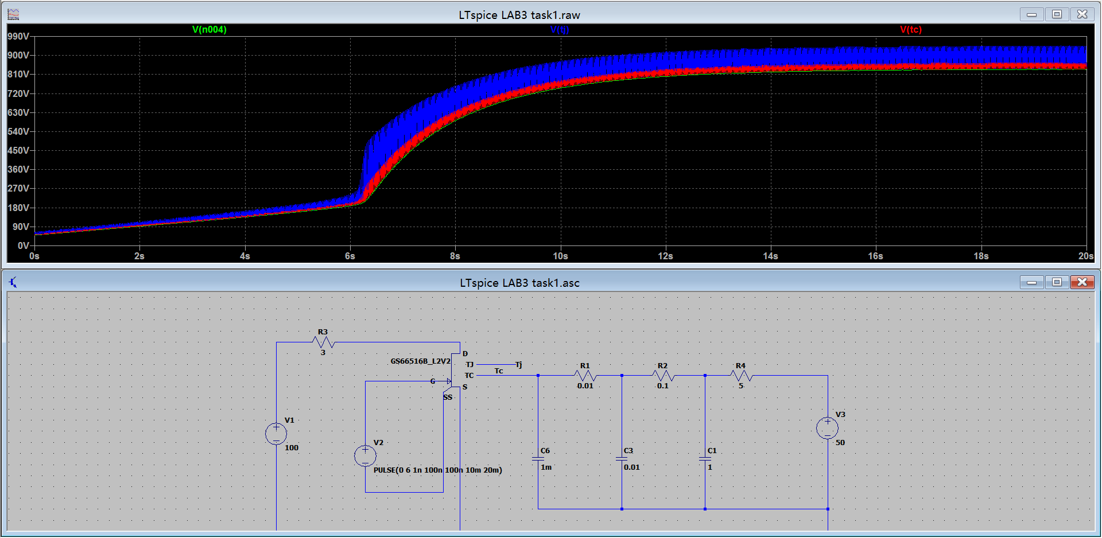
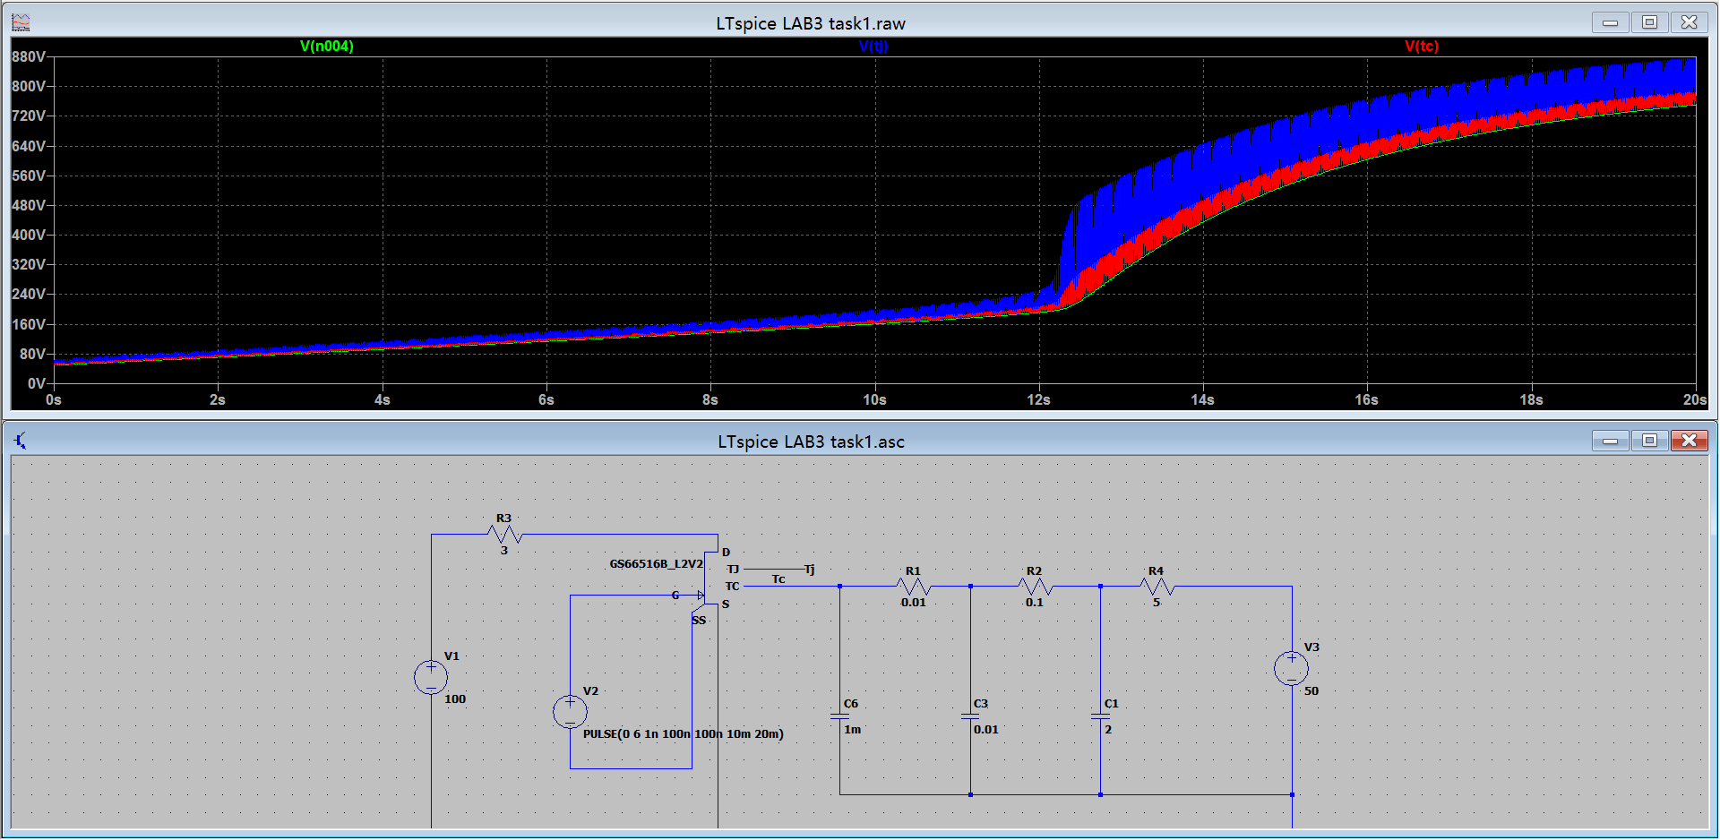
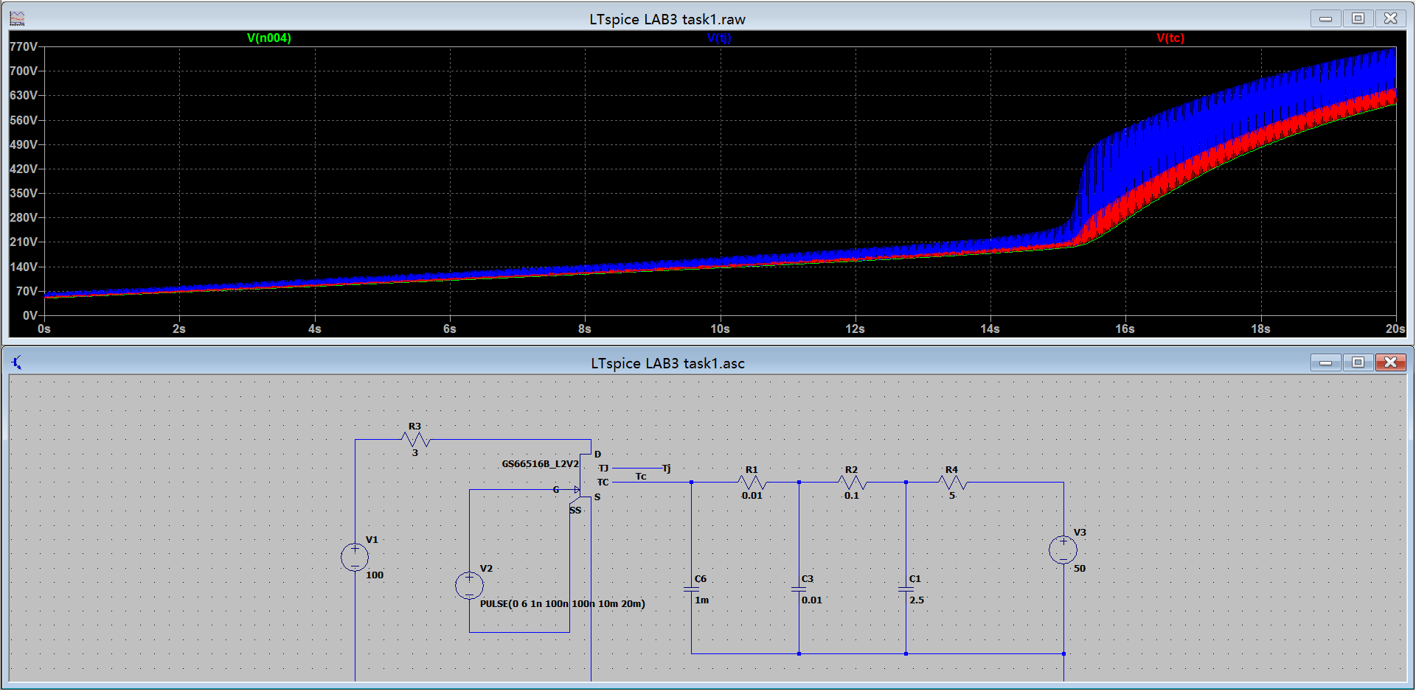
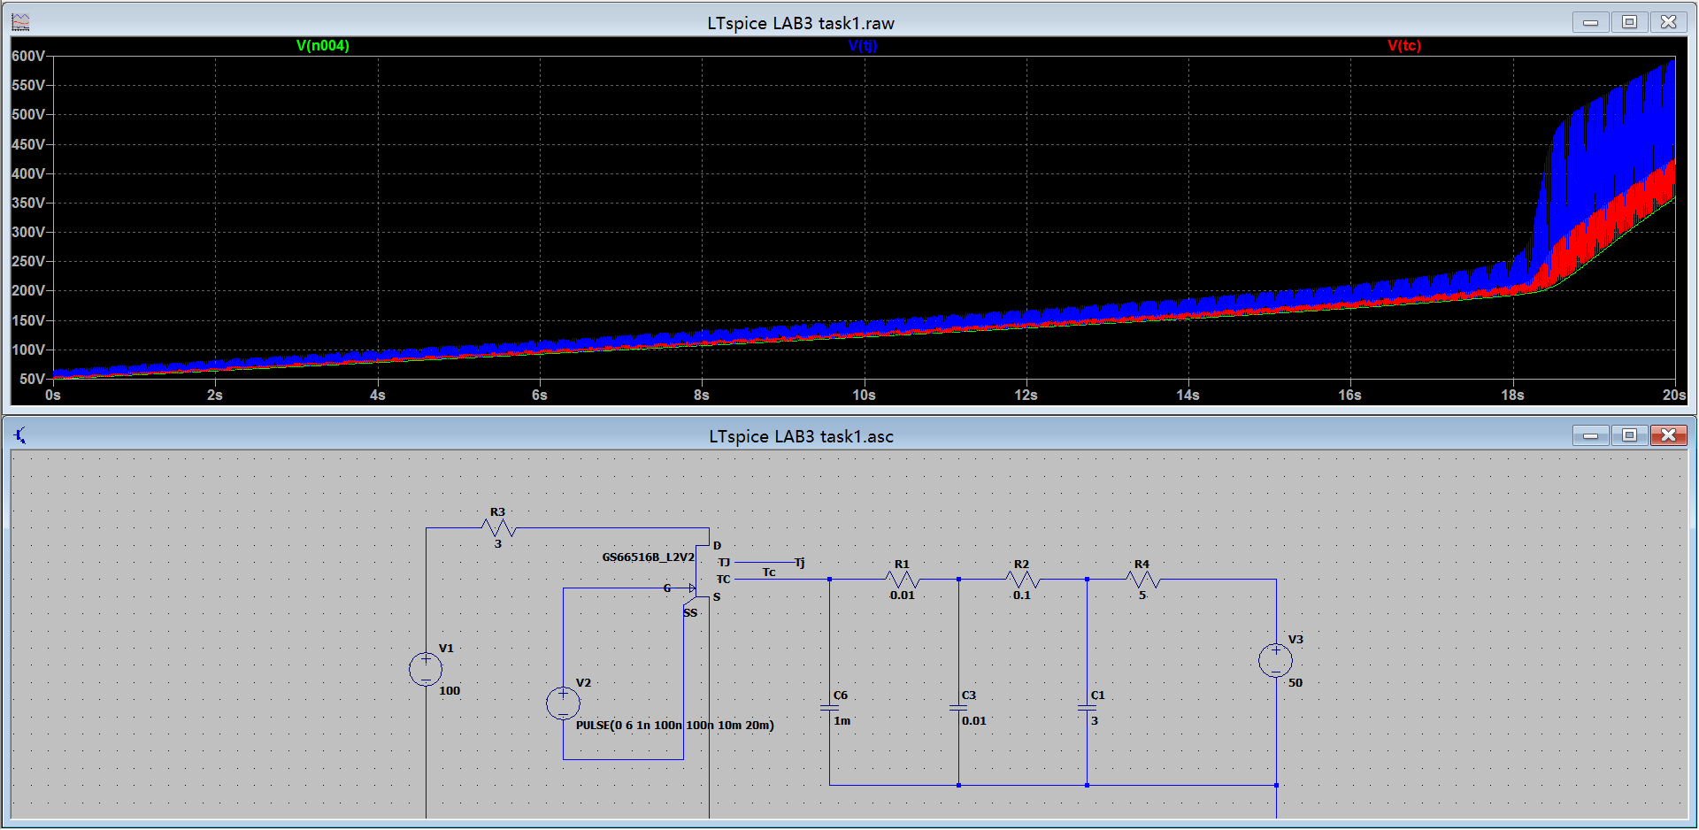
One effect is the value of capacitor1. So we simulated with 1F/2F/2.5F/3F separately. According to the simulation, we can sum up that the capacitance rising can delay the over heating time, striving for a longer time for the circuit to operate effectively.
Over heating time

Slide 4
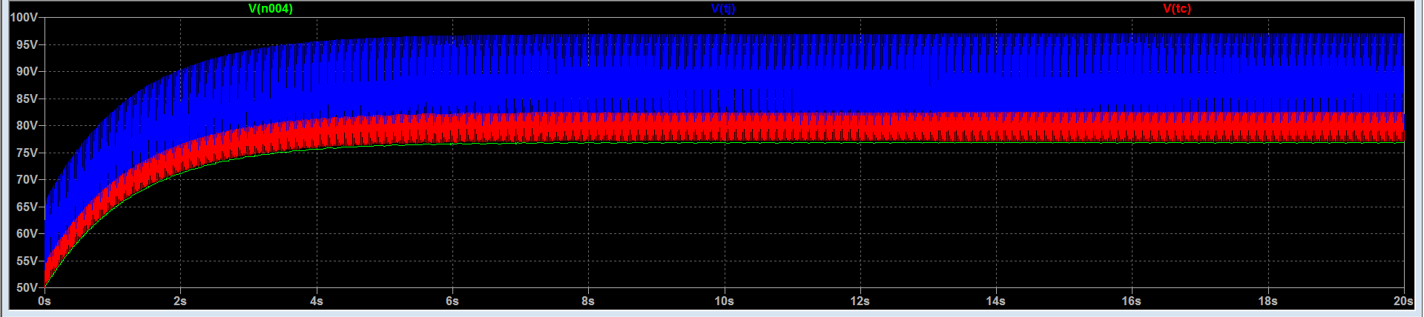
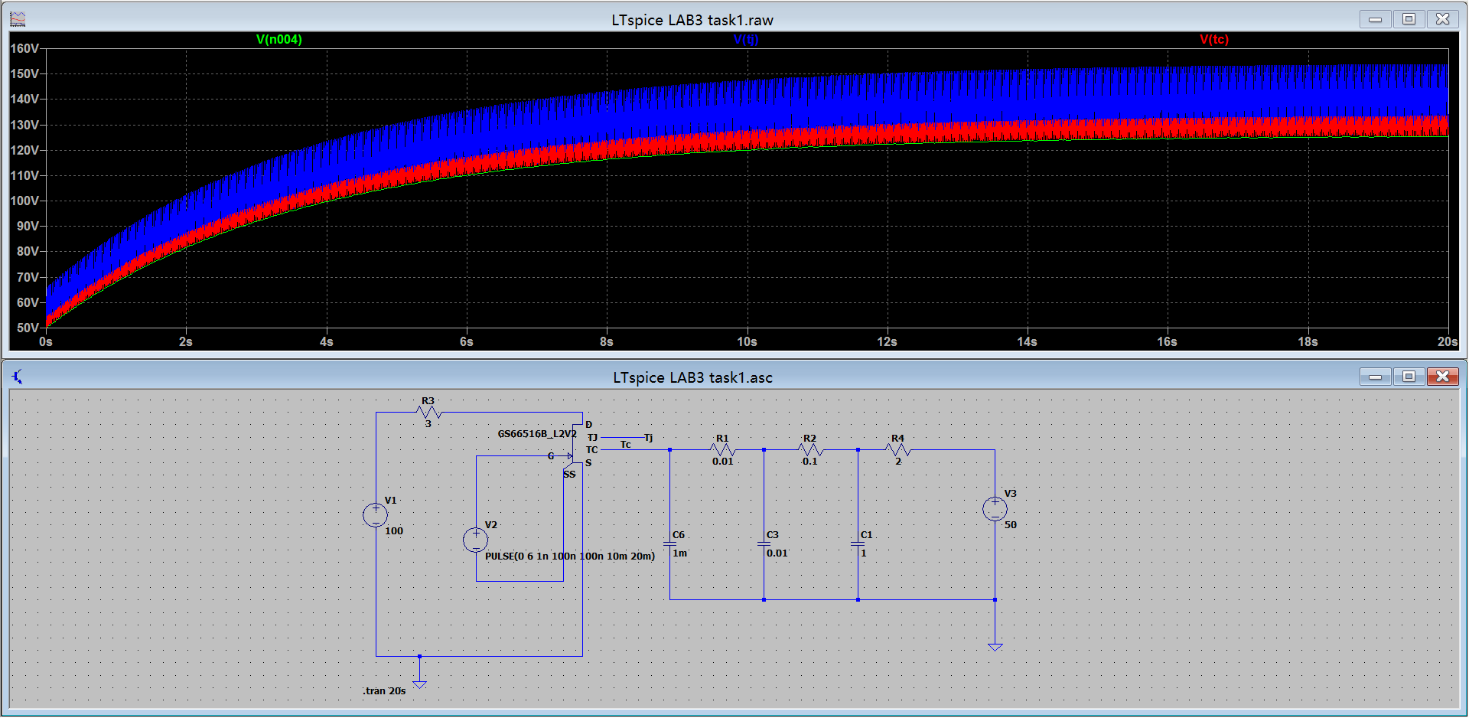
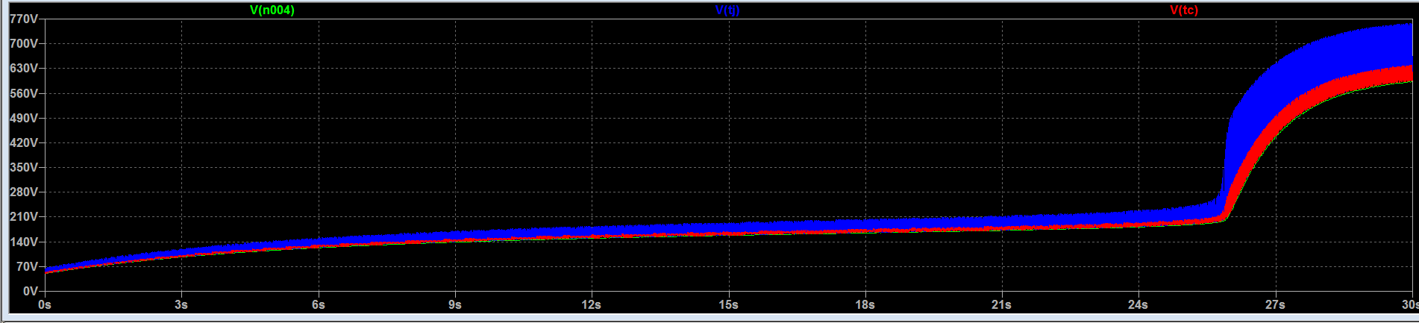
R4=1Ω,C1=1F & R4=2Ω,C1=1F
Another effect is resistor4
Resistance critical value is 2.3Ω, when over it, the circuit will fail with a dramatic rise and not affected by capacitance. And then we focus on effective parts which resistance lower than critical value. It shows that the higher resistor4 value we put, the more working time we get.
R4=2.3Ω,C1=1F & R4=2.4Ω,C1=1F

Slide 5
Important factors
Capacitor 1
Resistor 4
Voltage resource

Slide 6
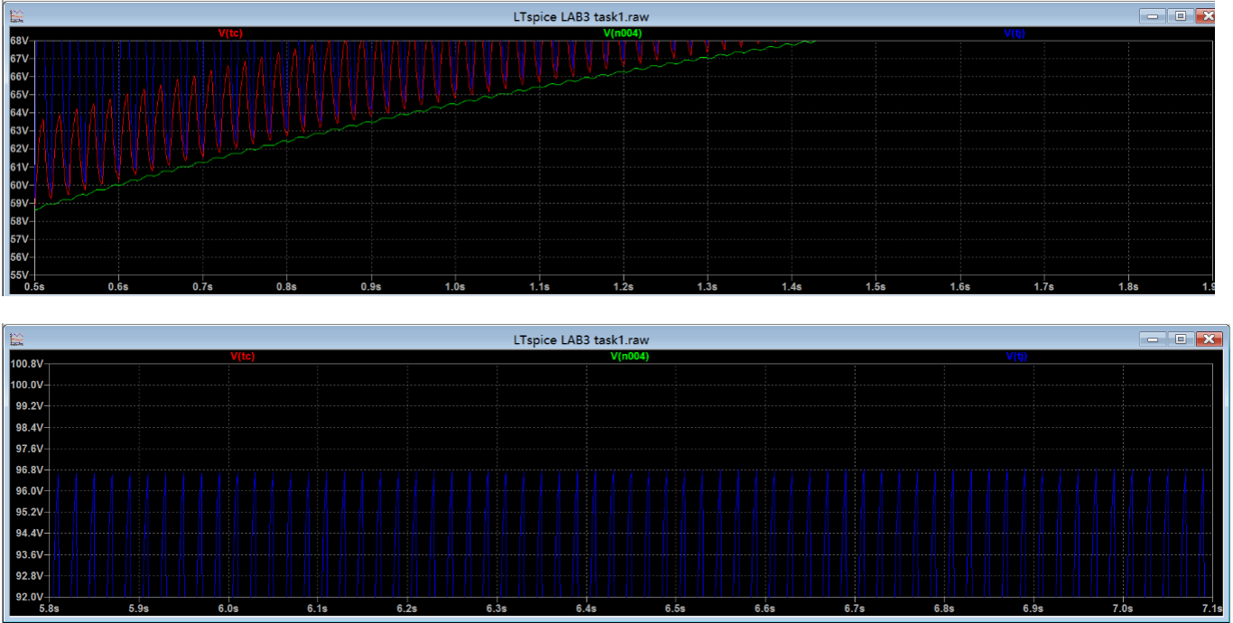
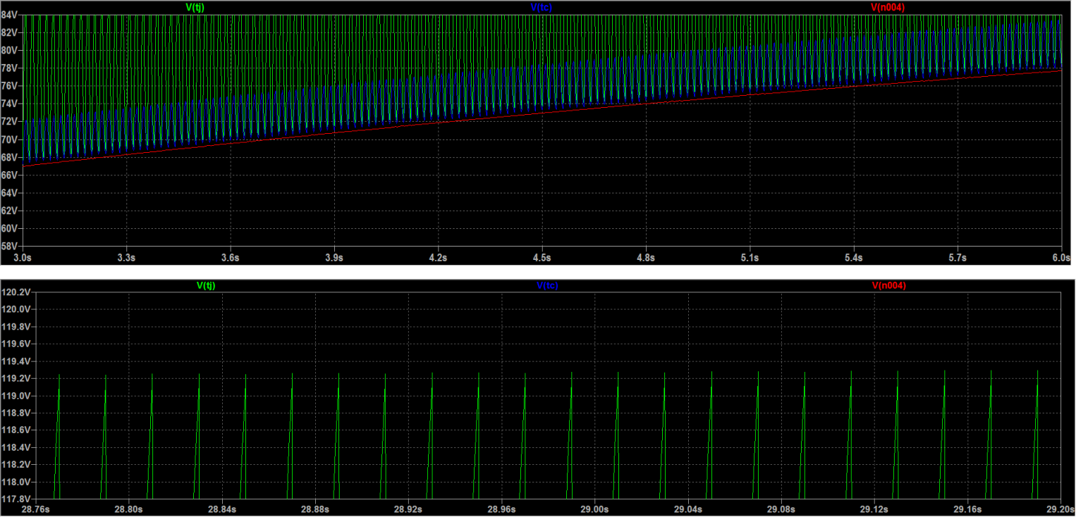
Calculate the dominant thermal time constant of the design.
The thermal time constant is the time which the time taken to reach 63.2% of the maximum temperature.
In the first set of figures, R4=1Ω, C1=1F and Tmax is 96.5℃. So the time is located at around 1s.
In the second set of figures, R4=1.5Ω, C1=3F and Tmax is 119.3℃. So the time is located at around 4.5s.
Thermal time constant= R₄×C₁

Slide 7
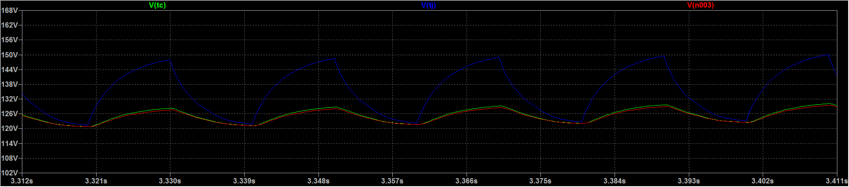
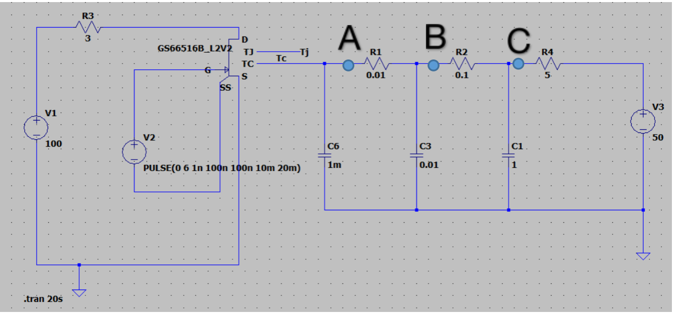
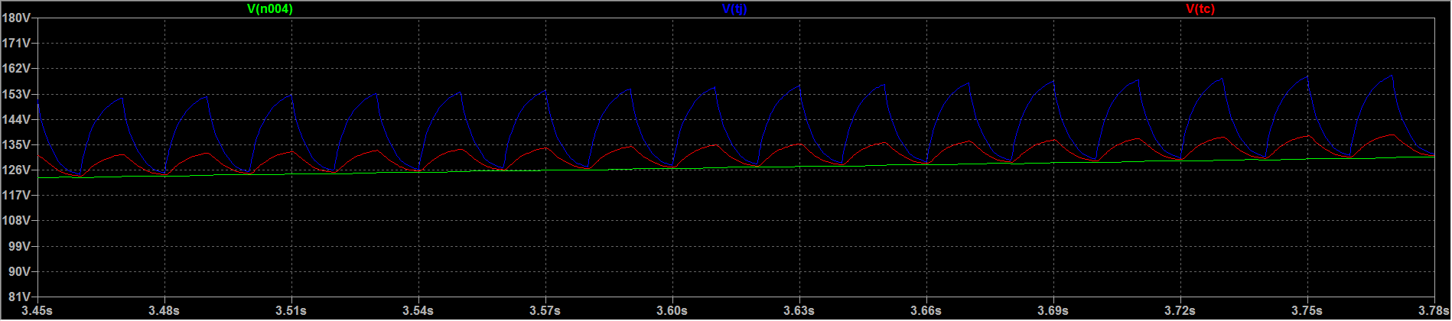
Safe operation
pointA&B
Make sure it will not over heating is our purpose. So we can set up some temperature sensors to control the operation temperature and stop working on time.
pointC

Slide 8
Thanks

